Slide 1
Adaptive Mail – A Flexible Email client app
Submitted by:
Gunavathi E
Harini S
Kaviya M
Vinotha V

Slide 2
Description
Adaptive Mail app is a sample project that demonstrates how to use the Android Compose Ul toolkit to build a conversational UI. The app simulates a messaging interface, allowing the user to send and receive messages, and view a history of previous messages. It showcases some of the key features of the Compose Ul toolkit, data management, and user interactions.

Slide 3
Required Depedencies
Basic Tools Front-End: For the app’s look and feel.
Use tools like: Flutter (for Android and iOS together) React Native (for cross-platform apps) Back-End: Handles the app’s logic and connects to email servers.
Use: Node.js (JavaScript-based) Python (Django or Flask frameworks)

Slide 4
Email Features Protocols: Use IMAP/SMTP to fetch and send emails. Support Microsoft Exchange or Office 365 using APIs like Microsoft Graph. Security: Add Oauth 2.0 for secure login (for Gmail, Outlook, etc.). Use encryption (like OpenPGP) for secure messages. Data Storage: Store user data (like saved emails) in databases. Cloud Storage: Firebase (easy for beginners). Local Database: SQLite (for offline storage).
Interface Desig: UI Frameworks:Material Design or Bootstrap for clean, modern layouts. Rich Text Editor: Allow formatting emails using tools like Quill.js.

Slide 5
Program Code:
// server.js
const express = require(‘express’);
const app = express();
const bodyParser = require(‘body-parser’);
const mongoose = require(‘mongoose’);
const cors = require(‘cors’);
const emailRoutes = require(‘./routes/emailRoutes’);
const userRoutes = require(‘./routes/userRoutes’);
app.use(cors());

Slide 6
App.use(bodyParser.json());
// Connect to MongoDB (assuming MongoDB Atlas or local DB)
mongoose.connect(‘mongodb://localhost/adaptive_mail’, { useNewUrlParser: true,
useUnifiedTopology: true });
// Define API routes
app.use(‘/api/emails’, emailRoutes);
app.use(‘/api/users’, userRoutes);
// Server listens on port 5000
3

Slide 7
App.listen(5000, () => { console.log(‘Server is running on http://localhost:5000’); }); Email Routes and Controller // emailRoutes.js const express = require(‘express’); const router = express.Router(); const emailController = require(‘../controllers/emailController’); router.post(‘/send’, emailController.sendEmail); router.get(‘/inbox’, emailController.getInbox); module.exports = router; // emailController.js const Email = require(‘../models/Email’);

Slide 8
// Function to send an email exports.sendEmail = (req, res) => { const { subject, body, recipient } = req.body; const newEmail = new Email({ subject, body, recipient, received: false, read: false, }); newEmail.save() .then(() => res.status(200).send(‘Email sent successfully’)) .catch(err => res.status(500).send(‘Error sending email: ‘ + err));

Slide 9
}; // Function to retrieve inbox exports.getInbox = (req, res) => { Email.find({ recipient: req.user.email }) .then(emails => res.status(200).json(emails)) .catch(err => res.status(500).send(‘Error fetching inbox: ‘ + err)); }; Email Service (API calls from frontend) // emailService.js import axios from ‘axios’; const API_URL = ‘http://localhost:5000/api/emails’; export const getInboxEmails = async () => {

Slide 10
try { const response = await axios.get(`${API_URL}/inbox`); return response; } catch (error) { throw error; } }; export const sendEmail = async (emailData) => { try { const response = await axios.post(`${API_URL}/send`, emailData); return response; } catch (error) { throw error; } };

Slide 11
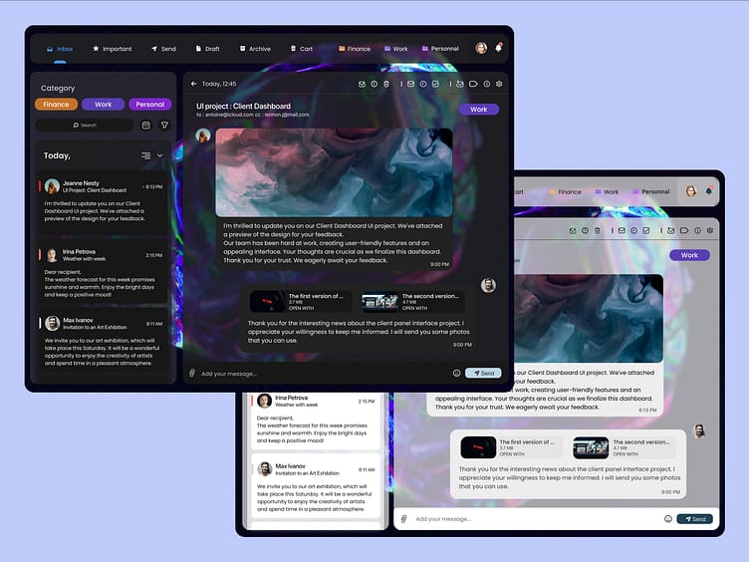
Output:

